Slide 1

CS-Y 6015 Software Engineering for Web Applications
Databases
Aleksandr Rogozin
March 7

Slide 2
Code Review:
Databases
public function up()
{
Schema::create('users', function(Blueprint $table)
{
$table->increments('id');
$table->string('name');
$table->string('email')->unique();
$table->string('password', 60);
$table->rememberToken();
$table->timestamps();
$table->timestamp('last_login_at')->nullable();
$table->text('prefers')->nullable();
});
}

Slide 3
Code Review:
Databases
class Plan extends Model
{
protected $table = 'plans';
protected $fillable = [
$table->increments('planId'
,'planName'
...
,'price'
];
}

Slide 4
Code Review:
Databases
class CreateBooksTable extends Migration
{
public function up()
{
//
Schema::create('users',function(Blueprint $table) {});
}
public function down()
{
//
}
}

Slide 5
Databases
Databases
There are two major database types:
RDBMS^{relational} vs NoSQL^{non-relational}

Slide 6
Relational Databases:
Databases
Oracle, Microsoft SQL, DB2, MySQL, PostgreSQL, MariaDB
Designed to scale up
More power, more resources needed
Structured data
Atomic transactions
Notes:
Relational Databases: Oracle, Microsoft SQL, DB2, MySQL, PostgreSQL, MariaDB
Designed to scale up
More power, more resources needed
Structured data
Atomic transactions

Slide 7
Relational Databases:
Databases
MyISAM
Simple to design and create
No foreign key relationships between tables
Faster than InnoDB, because of simpler structure
Full-text indexing
Good for read-intensive tables
Notes:
Simple to design and create
No foreign key relationships between tables
Faster than InnoDB, because of simpler structure
Full-text indexing
Good for read-intensive tables

Slide 8
Relational Databases:
Databases
MyISAM Limitations:
No foreign keys / cascading deletes/updates
No transaction integrity
No rollback abilities
Row limit of 4,284,867,296 rows
Maximum 64 indexes per row
Notes:
Limitations:
No foreign keys / cascading deletes/updates
No transaction integrity
No rollback abilities
Row limit of 4,284,867,296 rows
Maximum 64 indexes per row

Slide 9
Relational Databases:
Databases
InnoDB
Support for transactions
Row-level locking (to properly handle multiple concurrent requests)
Foreign key constraints ensure integrity of database structure
Support large buffer pool of data and indexes
Notes:
InnoDB
Support for transactions
Row-level locking (to properly handle multiple concurrent requests)
Foreign key constraints ensure integrity of database structure
Support large buffer pool of data and indexes

Slide 10
Relational Databases:
Databases
InnoDB Limitations:
No full text indexing (older versions below MySQL 5.6)
Cannot be compressed for fast read-only operations
Notes:
Limitations:
No full text indexing (older versions below MySQL 5.6)
Cannot be compressed for fast read-only operations

Slide 11
NoSQL:
Databases
MongoDB, Cassandra, Redis, CouchDB, Neo4J
Designed to scale out
Semi-structured data
Eventual consistency
Notes:
NoSQL: MongoDB, Cassandra, Redis, CouchDB, Neo4J
Designed to scale out
Semi-structured data
Eventual consistency

Slide 12
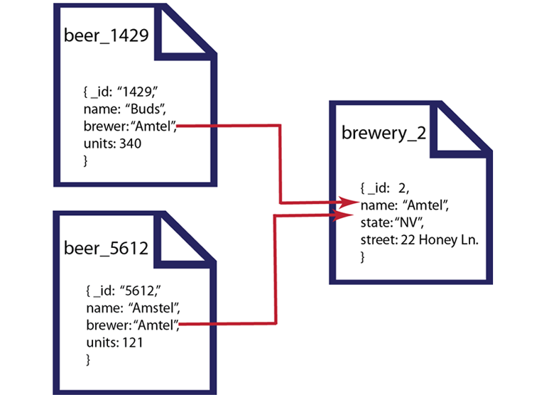
NoSQL:
Databases
Document-orientated
Document in this category is a JSON file
MongoDB
CouchDB

Slide 13
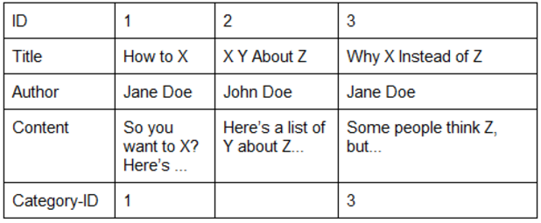
NoSQL:
Databases
Columnar
Cassandra
Amazon Dynamo DB

Slide 14
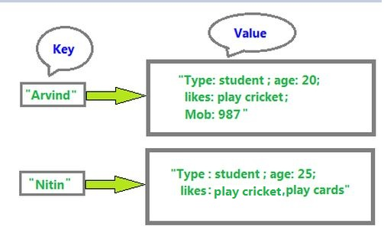
NoSQL:
Databases
Key-value
Great for speedy queries
Redis
Memcached

Slide 15
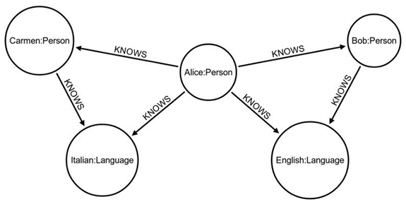
NoSQL:
Databases
Graph
Neo4J

Slide 16
Database Optimizations:
Databases
Rewrite queries
Change indexing strategy
Change schema
Server tuning

Slide 17
Database Relationships:
Databases
One-to-one
One-to-many
Many-to-many
Notes:
One-to-one: customer can have one account
One-to-many: customer can have many orders
Many-to-many: many items can be put in many orders

Slide 18
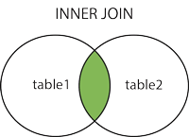
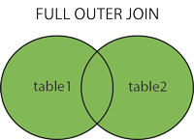
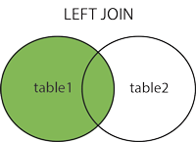
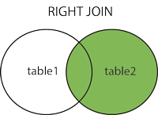
Database joins:
Databases

Slide 19
Object-Relational Mapping:
Databases
Object-relational mapping (ORM) is a mechanism that makes it possible to address, access and manipulate objects without having to consider how those objects relate to their data sources.
Notes:
Object-relational mapping (ORM) is a mechanism that makes it possible to address, access and manipulate objects without having to consider how those objects relate to their data sources. ORM lets programmers maintain a consistent view of objects over time, even as the sources that delivers them, the sinks that receive them and the applications that access them change.
ORM hides and encapsulates change in the data source itself, so that when data sources or their APIs change, only ORM needs to change to keep up—not the applications that use ORM to insulate themselves from this kind of effort. This capacity lets developers take advantage of new classes as they become available and also makes it easy to extend ORM-based applications. In many cases, ORM changes can incorporate new technology and capability without requiring changes to the code for related applications.

Slide 20
Active Records vs Data Mapper:
Databases
Active Record
Good:
Simple.
Easy to learn and understand.
Notes:
Active Record
Active Record maps an object to a database row. The model will be able to determine its properties automatically by looking at the database schema.
Each model object inherits from a base Active Record object and so you have access to all the methods relating to persistence. This makes the Active Record style very easy to get started with because it is very intuitive.
Good:
Simple. Because of how tightly matched the records in your database and the objects in your system are conceptually, it’s really easy to pick up a project, examine its database schema, and have a strong sense of what the project is doing. What makes this great is that the ORM layers have a minimal amount of indirection. What you see in the database or objects is likely what exists in the other.
Easy to learn and understand. This flows directly out of the simplicity, but you’ll also probably have a pretty intuitive understanding of how you can work with this system even if you’ve never had the least exposure to an ORM before. Its simplicity is merciful and easy.

Slide 21
Active Records vs Data Mapper:
Databases
Active Record
Bad:
Database coupling (and testing).
Performance bottlenecks.
Notes:
Database coupling (and testing). Because your database is so tightly coupled with your objects, you’ll have a hard time efficiently separating the two. Surely a good active record implementation is likely to make it pretty quick for you to switch from MySQL to Postgres, but it’ll not make it easy to use your objects without the database. The fact that most active record model-based systems are effectively impossible to separate (for testing or other reasons) is often held against them.
Performance bottlenecks. A very similar complaint about the active record pattern is that you’ll have a hard time dealing with performance bottlenecks when they arise. For small web-apps with a few hundred users this generally isn’t an issue, but the lack of SQL efficiencies that more complex systems of separation between your system objects and your database allow are a big roadblock as Active Record-based applications grow.

Slide 22
Active Records vs Data Mapper:
Databases
Data Mapper
Good:
Greater flexibility between domain and database.
Performance.
Notes:
Data mapper completely separates your model from the persistence layer. This means that your data model does not know anything about the database. Instead, you will need to rely on a separate service, Entity Manager, to save your model.
The big benefit of the Data Mapper pattern is, your domain objects don’t need to know anything about how they are stored in the database. This means that your objects will be lighter because they don’t have to inherit the full ORM, but also there will be a stricter, more formal process for interacting with the database because you can’t just call the save() method anywhere in your code.
Greater flexibility between domain and database. As we mentioned above, one of the prototypical reasons that you’ll want to use a data mapper is that you as the application architect do not actually have final say on the database scheme. Where you’ve got a historical database, or a new database with an unfriendly gatekeeper, the data mapper pattern allows you to hide the ways in which you database isn’t an ideal way to think about your domain behind the whole data-mapping layer.
Performance. Similarly, because you do have a layer of abstraction and indirection between your domain objects and your database, there’s a good possibility that you can have the data mapper make more efficient use of the database than a naive active record implementation would allow.

Slide 23
Active Records vs Data Mapper:
Databases
Data Mapper
Bad:
Intimidating and hard to set-up
Notes:
Intimidating and hard to set-up. The advantage of active record is that you build your database schema and objects side-by-side, so when you’ve got one you’ve got the other. Because the data mapper pattern is deeper than that, you’re inherently going to have to think a little harder to configure your data-mapping layer than you will a practically invisible active record layer.

